Slide 1

NAML
Credit Card Fraud Detection
Filippo Lazzati - Margherita Musumeci
04 - 02 - 2022

Slide 2
Purpose
Purpose
WHY?
WHAT ?
It is important that credit card companies are able to recognise fraudulent credit card transactions so that customers are not charged for items that they did not purchase.
The information of transactions made by credit cards in September 2013 by European cardholders
has to be analysed exploiting three methods:
• Logistic Regression;
• KNN (k-nearest neighbours);
• Naive Bayes.

Slide 3
Dataset
Dataset
Time | V1 | V2 | … | V28 | Amount | Class

Slide 4
Preprocessing
Preprocessing
NORMALIZE
SHUFFLE
SPLIT
RANDOM UNDER SAMPLING
50:50
30%
34:66
70%
25:74
Notes:
To change the image behind the Mock up.
Select the layer - > Right Click -> Send to Back -> Delete the image -> Drag & Drop your Own Picture -> Send to Back (again)

Slide 5
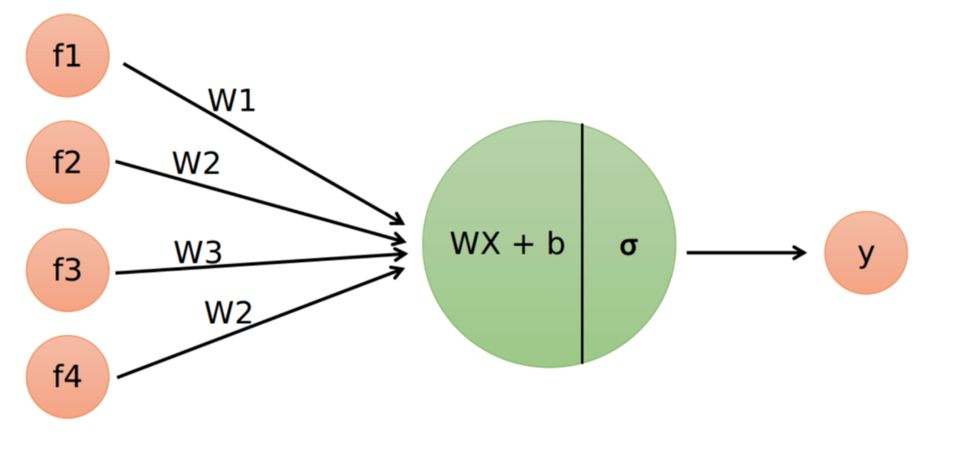
Logistic Regre
Logistic Regression

Slide 6
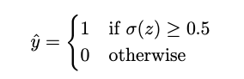
Prediction
LOGISTIC REGRESSION
Prediction
Since the output of the sigmoid function belongs to [0, 1], it can be interpreted as a likelihood, thus the final prediction can be retrieved through a threshold function:
Notes:
To change the image behind the Mock up.
Select the layer - > Right Click -> Send to Back -> Delete the image -> Drag & Drop your Own Picture -> Send to Back (again)

Slide 7
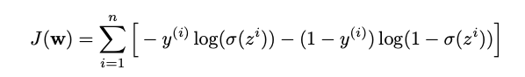
Loss
LOGISTIC REGRESSION
Loss
The loss function can be found by applying the maximum likelihood method to p(y|x, w), and then negate the obtained log-likelihood function in order to have a loss function to minimize:
Notes:
To change the image behind the Mock up.
Select the layer - > Right Click -> Send to Back -> Delete the image -> Drag & Drop your Own Picture -> Send to Back (again)

Slide 8
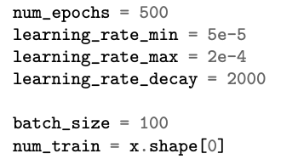
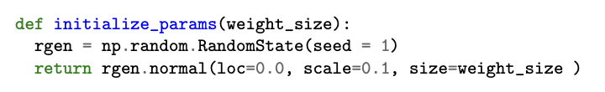
Stochastic
LOGISTIC REGRESSION
Stochastic Gradient Descent
It can be minimised through the stochastic gradient descent (SGD) with linear decay of the learning rate
to obtain the parameters to use for making the predictions.
Notes:
To change the image behind the Mock up.
Select the layer - > Right Click -> Send to Back -> Delete the image -> Drag & Drop your Own Picture -> Send to Back (again)

Slide 9
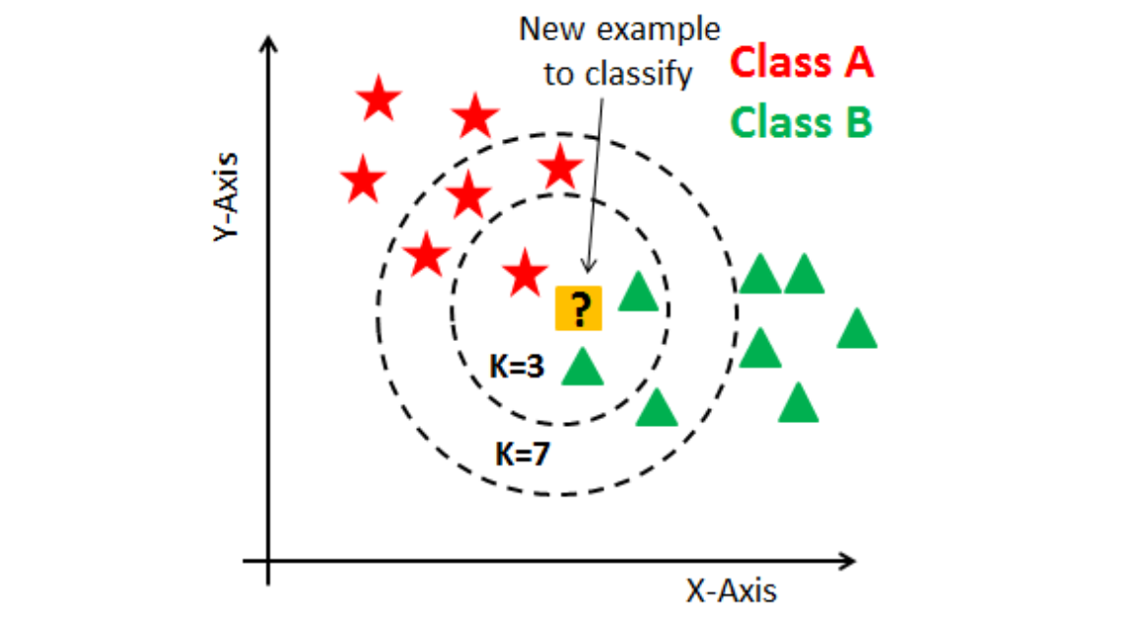
K-Nearest Neig
K-Nearest Neighbours

Slide 10
Lazy training
K-NEAREST NEIGHBOURS
Lazy training
K-Nearest neighbours does not learn anything. It simply exploits the entire training set to perform a prediction.
Notes:
To change the image behind the Mock up.
Select the layer - > Right Click -> Send to Back -> Delete the image -> Drag & Drop your Own Picture -> Send to Back (again)

Slide 11
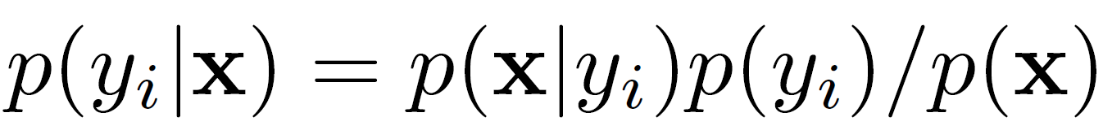
Naïve Bayes
Naïve Bayes

Slide 12
Asuumptions
Naïve Bayes
Assumptions
Naïve Bayes algorithm allows to apply the Bayes theorem under a set of assumptions:
1) the features x1, x2, ..., xn are independent of each other
2) the distribution of each p(xj |yi) is known
Notes:
To change the image behind the Mock up.
Select the layer - > Right Click -> Send to Back -> Delete the image -> Drag & Drop your Own Picture -> Send to Back (again)

Slide 13
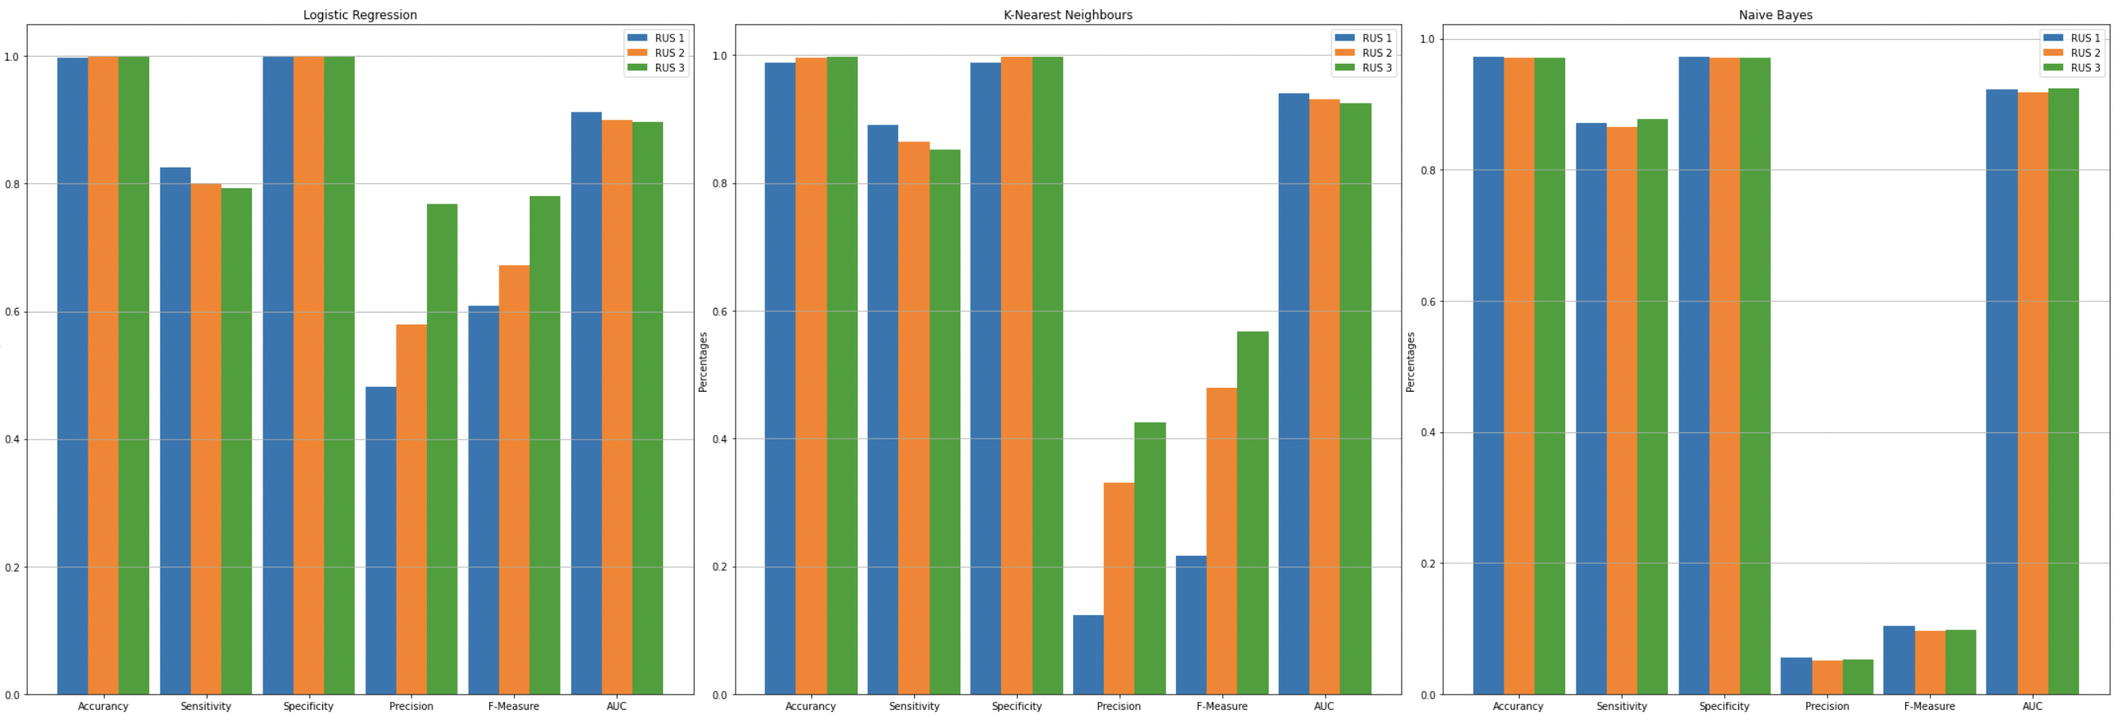
Performances
Performances Evaluation

Slide 14
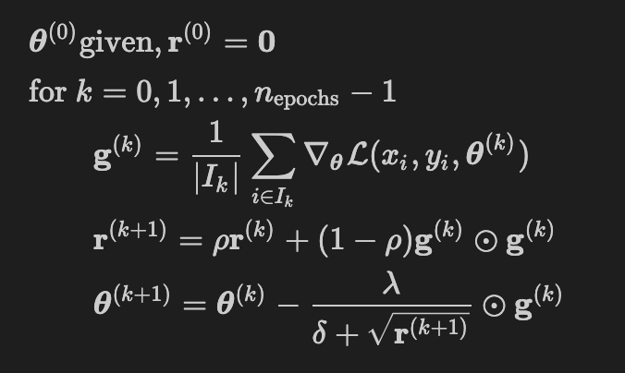
Artificial Neural
Network
30
20
10
2
One-hot representation
Xavier Uniform initialization
Tanh + SoftMax activation functions
Cross Entropy as loss function
Root Mean Squared Propagation for training

Slide 15
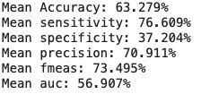
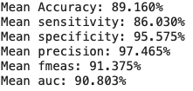
K-fold cross-va
K-fold cross-validation
KNN
NB

